Slide 1
Classify URL Reputation
Randy Grant (DSML)
Notes:
Metropolitan Transportation Authority

Slide 2
Introduction
Issue: The client, CyberCents, needs a way to able to identify URLs that have a likelihood of not being benign prior to a DNS request being sent to a DNS sinkhole
Solution: With a list of URLs that have a known reputation of benign or not benign, train a classification model to identify URLs as being “benign” or “not benign” to be deployed as a preliminary check of URLs before being sent to the DNS server
Goal: Create a model that correctly identifies URLs more than 90% of the time

Slide 3
Methods
Data Used:
Kaggle.com sample datasets
Tools Used:
Python for model development
Excel
Metrics Created:
Scores of Baseline Models
Scores of Best Hyperparameter Tuned Models
Rate of False and True Positives
Final Ensemble Model Score and Confusion Matrix

Slide 4
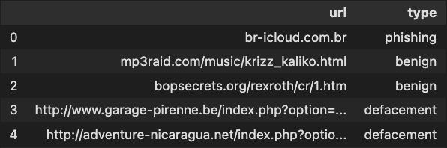
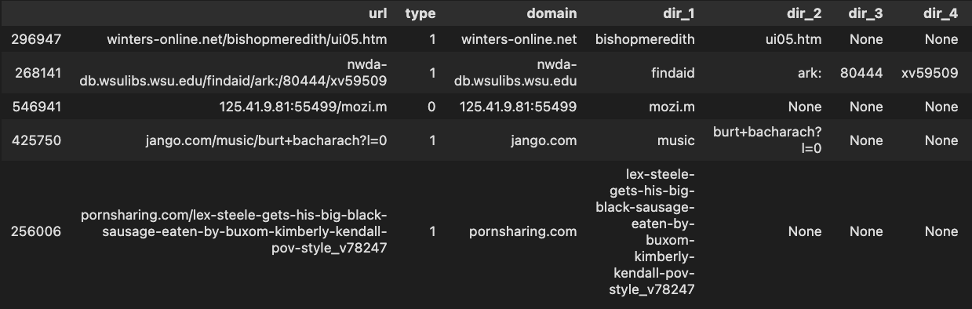
Sample Data
Raw
Training Data Snippet

Slide 5
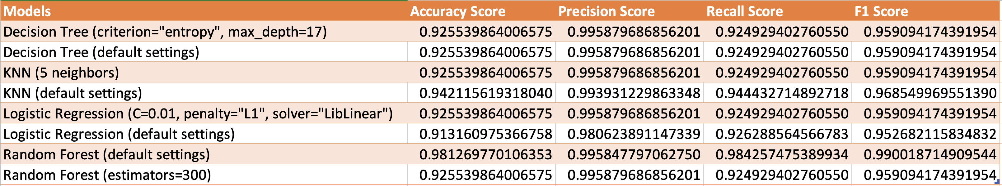
Raw Scores

Slide 6
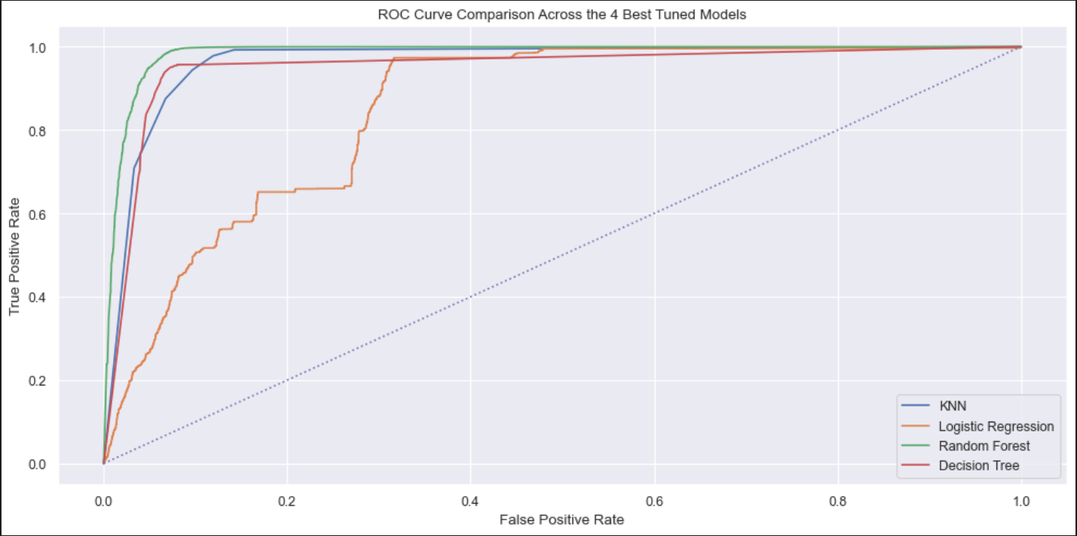
Rate of False and True Positives with Tuned Models

Slide 7
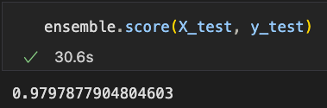
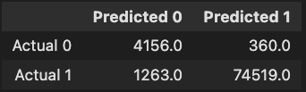
Ensemble Model - Chosen as Deployable Model
Score
Confusion Matrix

Slide 8
References
365 Data Science, ML in Python course, section 4.9
https://splunkbase.splunk.com/app/2734/
https://web.archive.org/web/20161130185550/http://fsecurify.com/using-machine-learning-detect-malicious-urls/
https://stackoverflow.com/a/50084009
https://datascienceparichay.com/article/pandas-split-column-by-delimiter/
https://stackoverflow.com/questions/37335598/how-to-get-the-length-of-a-cell-value-in-pandas-dataframe
https://stackoverflow.com/questions/49234374/how-to-count-vowels-and-consonants-in-pandas-dataframe-both-uppercase-and-lower
https://stackoverflow.com/questions/13174468/how-do-you-join-all-items-in-a-list
https://machinelearningmastery.com/modeling-pipeline-optimization-with-scikit-learn/
https://machinelearningmastery.com/modeling-pipeline-optimization-with-scikit-learn/
https://towardsdatascience.com/ensemble-learning-in-sklearn-587f21246e8d
https://stackoverflow.com/questions/332289/how-do-i-change-the-size-of-figures-drawn-with-matplotlib
https://towardsdatascience.com/ensemble-learning-in-sklearn-587f21246e8d

Slide 9

Thank you!
Questions?

